Slide 1
NOTEPAD APPLICATION IN JAVA
JOYDIP SARKAR
PRINCE RAJ
MANISH KUMAR

Slide 2
PROJECT OVERVIEW
This project is about designing a simple notepad using the common features provided by java.
Here we can use various operation like cut , copy , paste , create , open , edit any text file etc.
This project is completely designed over common java features.

Slide 3
INTRODUCTION
Notepad is a basic text editor for Microsoft Windows. It has been included in all versions of Microsoft Windows since Windows 1.0 in 1985.
It can use to create simple documents. The most common use for Notepad is to view or edit text (.txt) files , but many users find Notepad a simple tool for creating Web pages.
Because Notepad supports only very basic formatting , you cannot accidentally save special formatting in documents that need to remain pure text. This is especially useful when creating HTML documents for a Web page because special characters or other formatting may not appear in your published Web page or may even cause errors

Slide 4
WHY NOTEPAD IN JAVA?
Java is platform independent Language. It can Run on any Operating System which has JVM installed.
One can not use Windows notepad in other Operating System.
So for Simplify the use of Notepad of Windows in Other Operating System with ease, The Notepad is Developed in Java.
The main objective of this project is to edit or update the text as you want. It acts like as windows notepad so having all of the function of it. Thus it makes a very important role in the Text Editing.

Slide 5
BASIC FEATURES
The Notepad application is a menu driven application that performs text editing operations:-File-Edit-Format
File operations include:
-New file -Opening existing files
-Saving the files -Saving the existing file with
another name -Exiting the application
Edit Operations Include:
-Undo -Cut
-Copy -Paste
-Find and Replace -Find Next
-Delete -Select all
-Time/Date
Format Operations Include:
-Font

Slide 6
WORKING MODEL
Display blank page with editing options.
Main function
Typing Function
Starting Function
File Handling
Create new file
Writing file
Reading file

Slide 7
SYSTEM REQUIREMENT
Computer with any Operating System.
Java Installed Platform.
Basic Memory.
Language: English

Slide 8
ARCHITECTURE OF NOTEPAD APP.
NOTEPAD APPLICATION
FILE MENU
FORMAT MENU
EDIT MENU

Slide 9
ARCHITECTURE OF FILE MENU
FILE MENU
NEW
OPEN
SAVE
SAVE AS
EXIT

Slide 10
ARCHITECTURE OF EDIT MENU
EDIT MENU
UNDO
DATE & TIME
CUT
SELECT ALL
COPY
DELETE
PASTE
FIND & REPACE
FIND NEXT

Slide 11
ARCHITECTURE OF FORMAT MENU
FORMAT
SELECT FONT

Slide 12
IMPLEMENTING TEXT EDITOR APPLICATION
Importing the inbuilt Java libraries.
Declaring the variables.
Designing the Notepad interface.
Adding listeners for tracking various events of the Notepad.
Handling of text editing events.

Slide 13
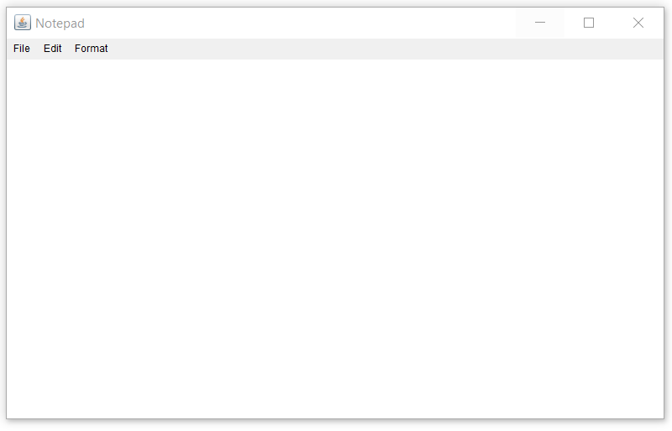
OUTPUT
Frame
Menu Bar
Text Area
NOTEPAD APPLICATION

Slide 14
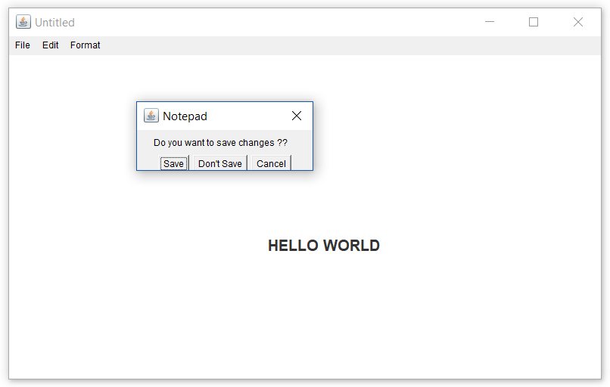
NEW FILE OPTION – resulting in save functionality
Being called

Slide 15
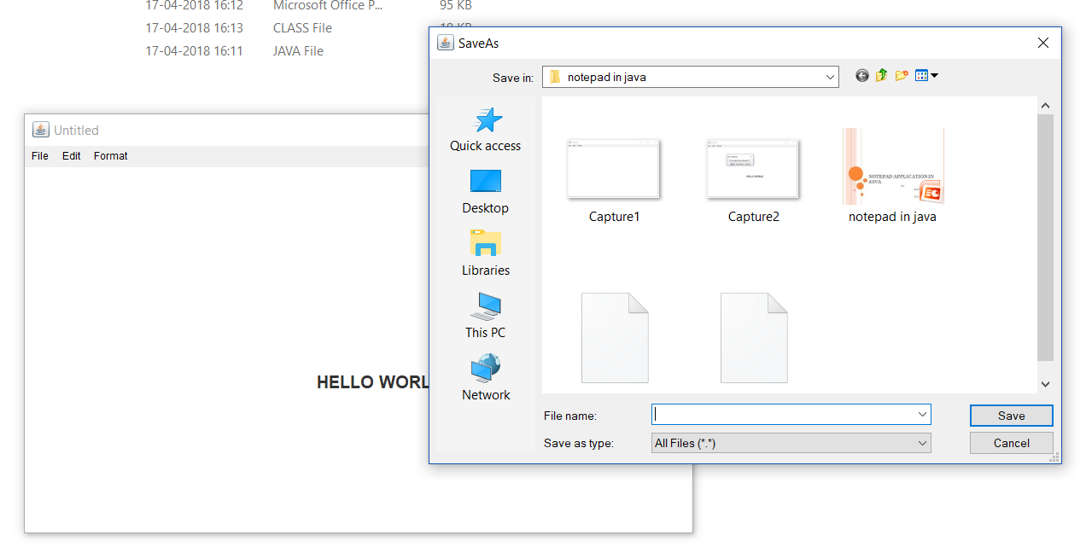
SAVE AS OPTION

Slide 16
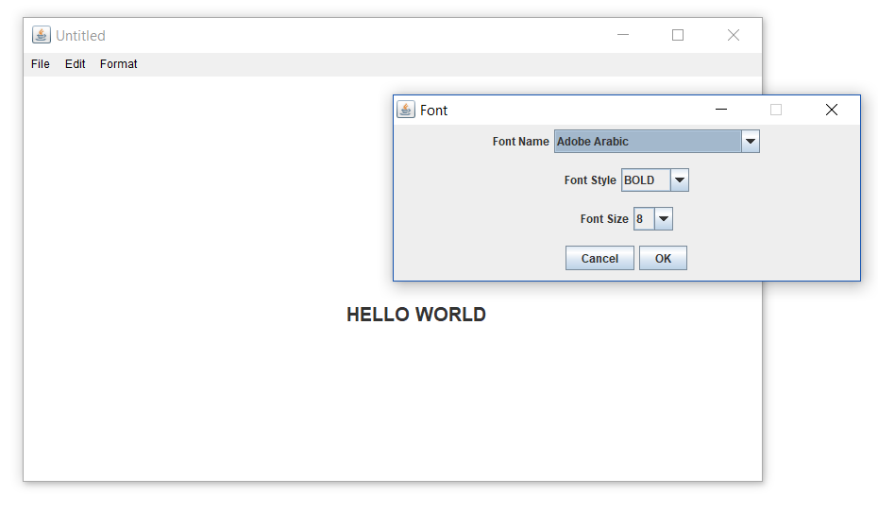
FONT SELECTION OPTION

Slide 17
THANK YOU

